Slide 1
Algae and Biofuel
St. Paul’s Co-educational College

Slide 2
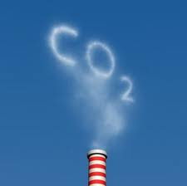
Introduction
alleviate the problem of excessive carbon emission
photosynthesis: CO₂ taken in
biofuel: renewable

Slide 3
Hong Kong
Not suitable for energy crop plantation
  e.g. sunflower seed, sugar cane
  mountainous terrain
  limited flat land
limited biofuel resources
→Algae!

Slide 4
Outline of our project
Divided into 2 parts
Part 1: Suitable conditions for algae growth
Part 2: Compare of oil content of algae with other common food substances

Slide 5
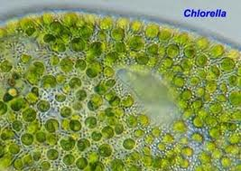
Method - part 1
Algae selected: Chlorella pyrenoidosa
  accessible and cheap
best growing conditions of Chlorella pyrenoidosa
  →great yield of algae → great amount of biofuel
  concentration of iron(II) ions in culture medium
  light intensity
  types of culture medium
  temperature

Slide 6
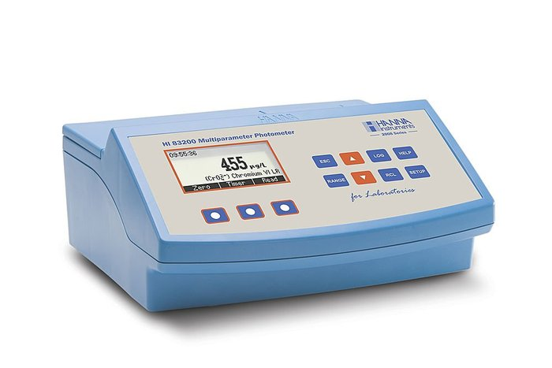
Method - part 1
Method of measuring
  optical density with use of colorimeter
  percentage change in optical density as compared to the 1st day presented in a graph

Slide 7
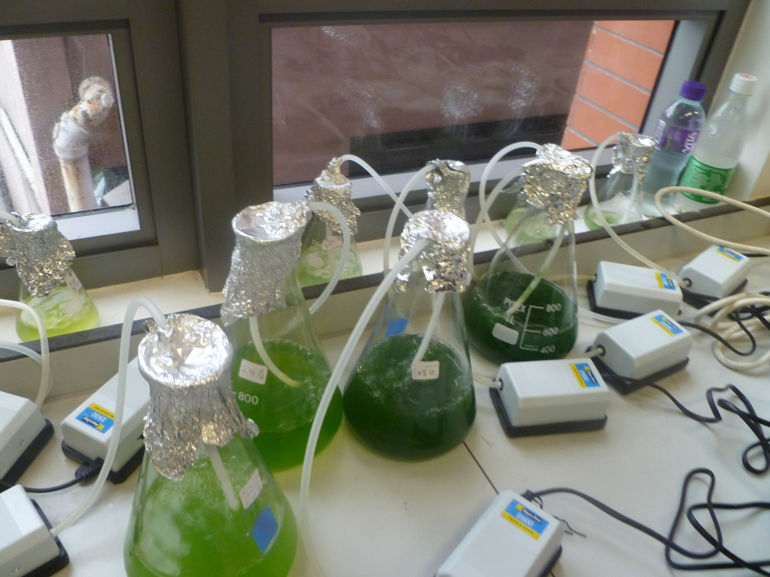

Slide 8
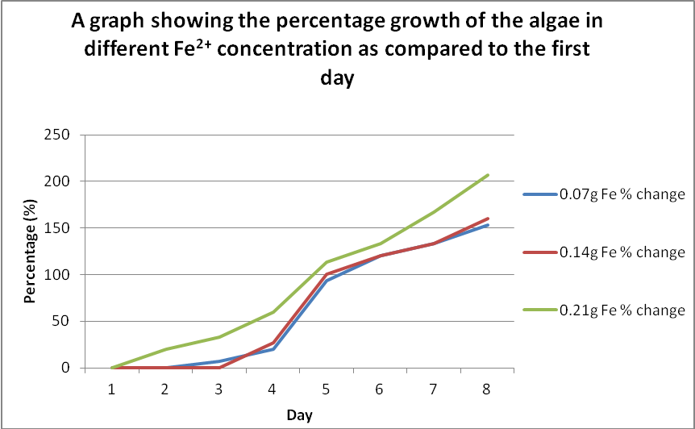
Important Graphs

Slide 9
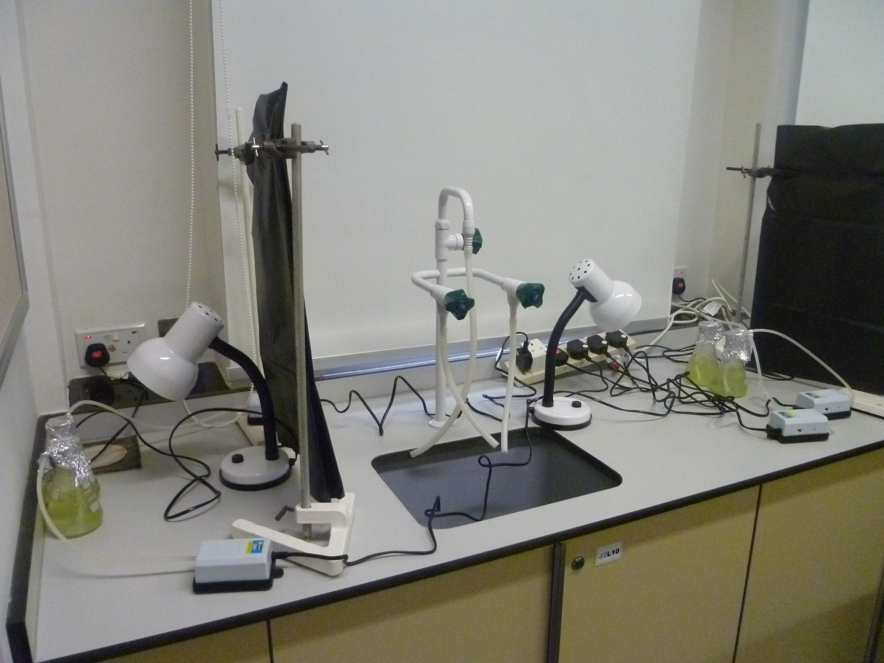

Slide 10
A Graph showing the percentage growth of the algae at different light intensities as compared to the first day in Kuhl solution

Slide 11
Important Graphs
A Graph showing the percentage growth of the algae at different light intensities as compared to the first day in Basal medium

Slide 12
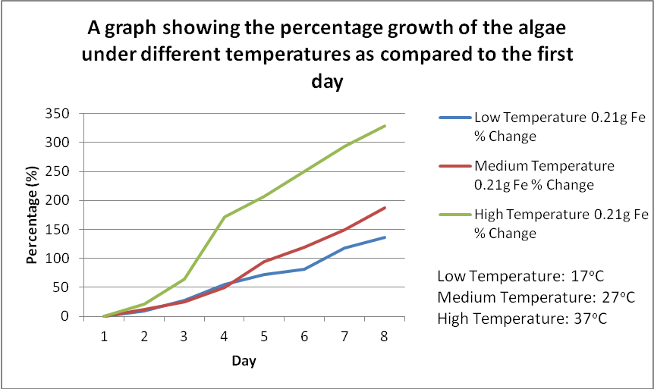
Important Graphs
21°C

Slide 13
Method - part 2
Algae selected: Spirulina platensis
  accessible and cheap
Test 1
  select sources of biofuel for comparison with Spirulina platensis in Test 2
Test 2
  extracted oil from Spirulina platensis
  Compare with other selected sources of biofuel

Slide 14
Method - part 2
Finding better sources of biofuel among:
  sunflower seed
  peanut
  orange peel
  coffee powder
Finding the most efficient reagent for extraction of the biofuel among:
  methyl acetate
  hexane
  ethanol

Slide 15
Method - part 2
Procedures:
  make sources of biofuel into dry powder
  introduce powder into organic solvents
  remove organic solvents after shaking
  measure volume of oil

Slide 16
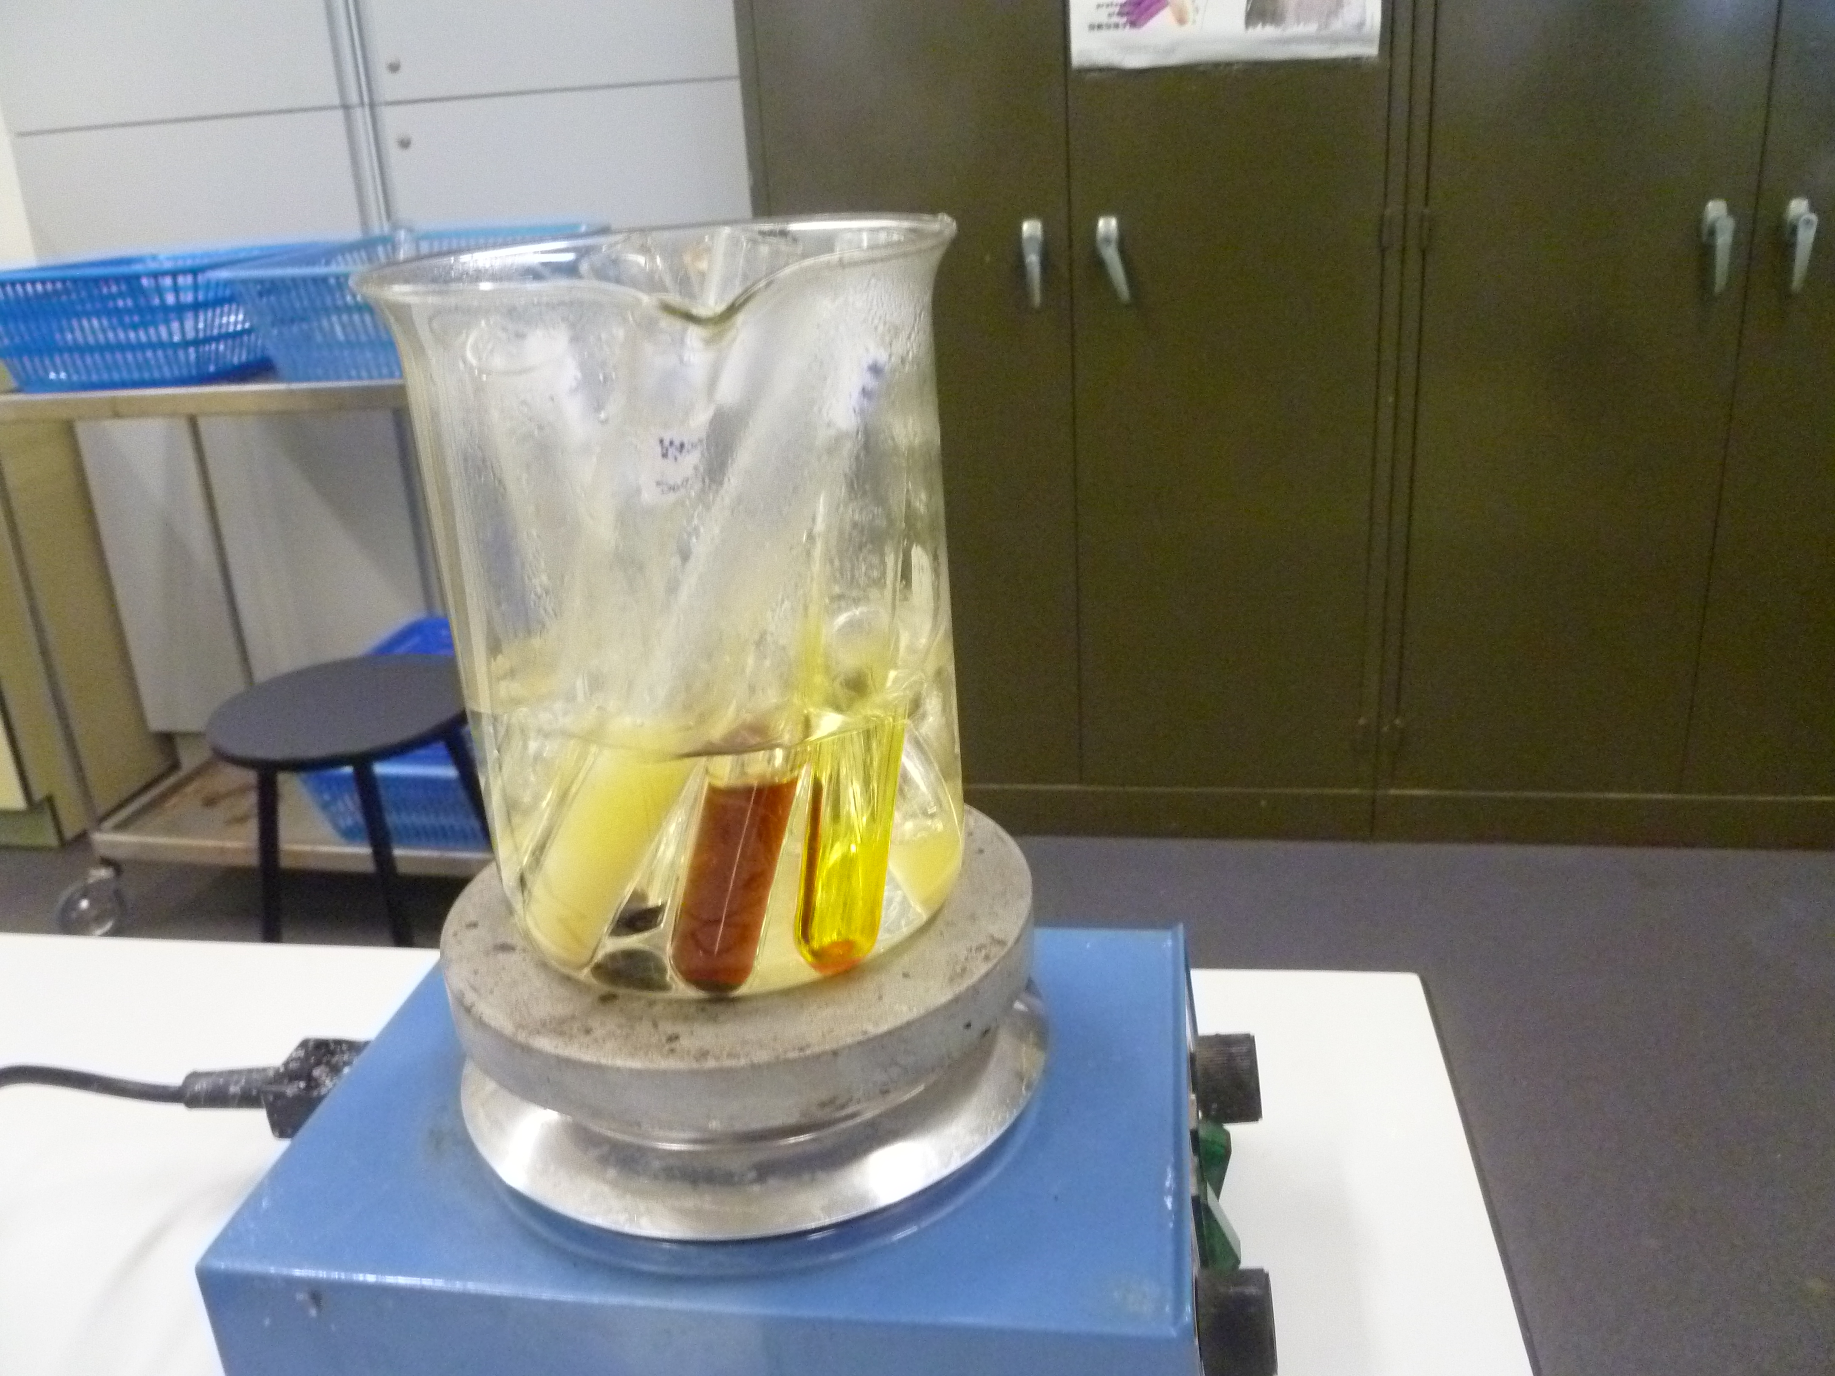

Slide 17
Results Test 1
 | Volume of oil collected (mL)
 | Methyl acetate | *Hexane | Ethanol
*Sunflower seed | 1.5 | 2.0 | 1.0
*Peanut | 1.0 | 2.5 | 1.0
Orange peel | 0.5 | 1.0 | 0.5
Coffee powder | 0.5 | 1.0 | 0.5

Slide 18
Method - part 2 Test 2
Organic solvent: hexane
Sources of biofuel:
  sunflower seed
  peanut
  pure Spirulina platensis powder

Slide 19
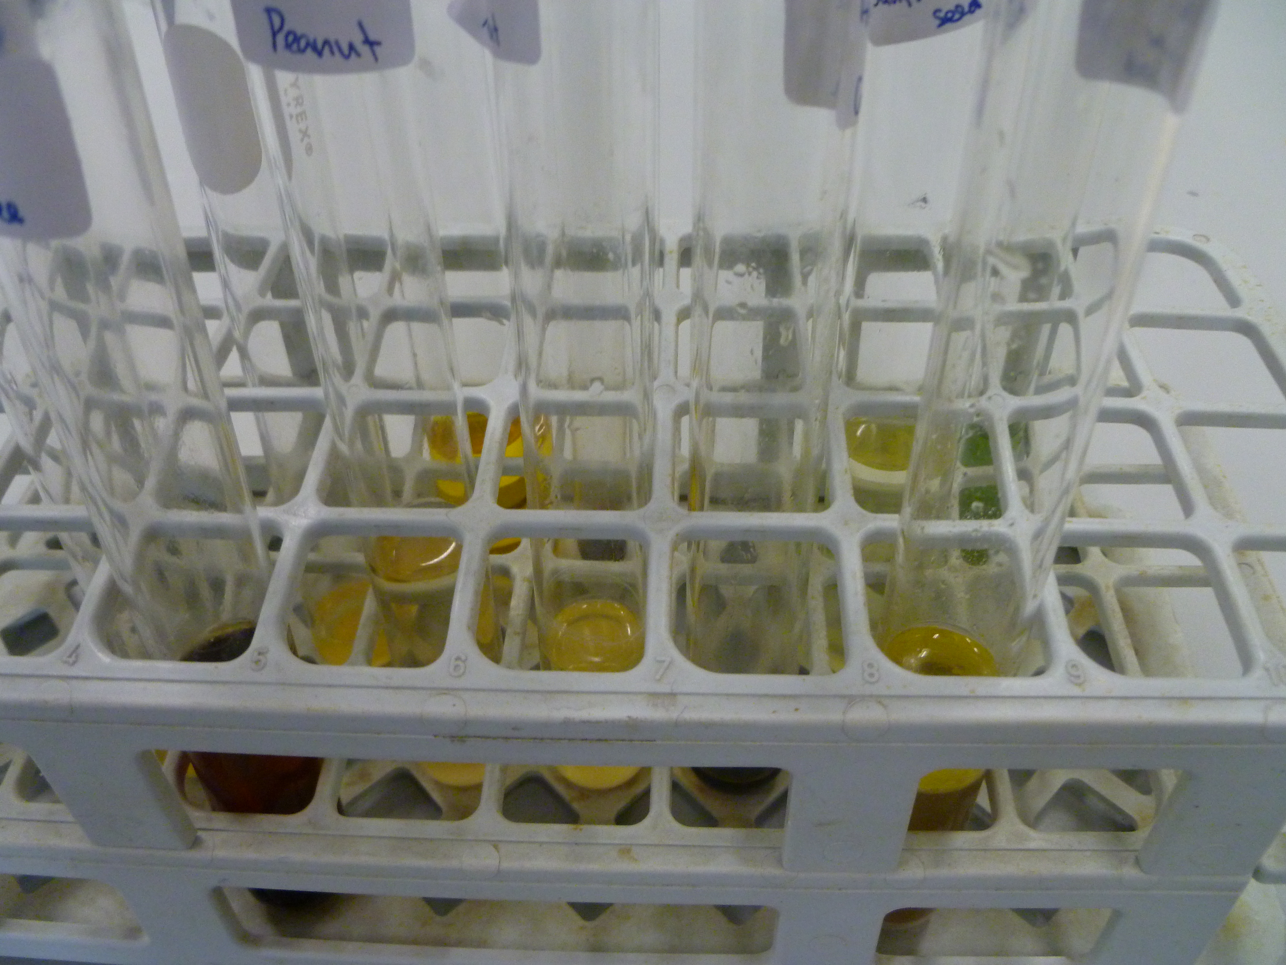

Slide 20
Results Test 2
Types of biofuel sources | pure spirulina platensis | sunflower seed | peanut
Volume of oil collected (mL) | 1.0 | 1.0 | 1.5

Slide 21

Significance
Advantages of using algae as biofuel
  Many algal species are highly reproductive
  →maximize biofuel yield
  only need salty seawater and suitable minerals present in the seawater to grow
  →do not have high intraspecific competition

Slide 22
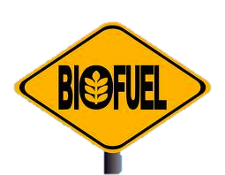
Using algae in Hong Kong
  Hong Kong’s water is suitable for algae growth
  e.g.817 harmful algal bloom incidents in 1975 to 2009
  suitable species of algae is used
  →remove harmful substances in the seawater
  → have a yield high enough to generate biofuel

Slide 23
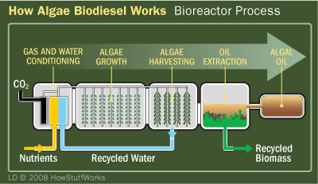
Applications overseas
  Large-scale reactors are created
  →make use of the advantage that the algae has high reproductive rate

Slide 24
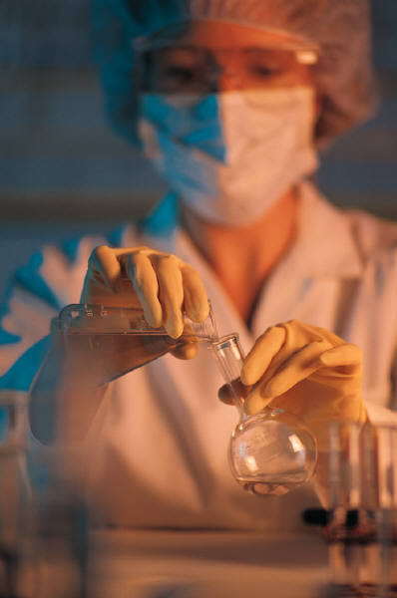
Investment in overseas and enhancing economic feasibility
  Much money was invested in biofuel developed from algae
  The technology is being more and more mature

Slide 25
Thank you!

Slide 26
