Slide 1
Investigating the potential of withered leaves as adsorbents of heavy metal ions
Shawn Tan Cheng Yue
Darryl Chai Min Shen

Slide 2
Background
Heavy Metal Pollution: International major environmental issue.
Discharge into water bodies→Adverse effects
Chromium
Lead
Cadmium

Slide 3
Background
Guava Leaf Litter: Remove Dye
Shorea robusta: Phenol
Biscutella Laevigata: Cadmium hyperaccumulator
Tea Leaves
Past Research

Slide 4
Rationale
Conventional Methods:
Ion exchange
Reverse Osmosis
Activted carbon
Cons:
High Capital
High energy usage
Disposal of metal residues
Demand for cheaper and environmentally-friendly alternative

Slide 5
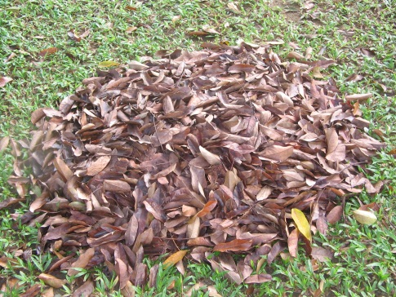
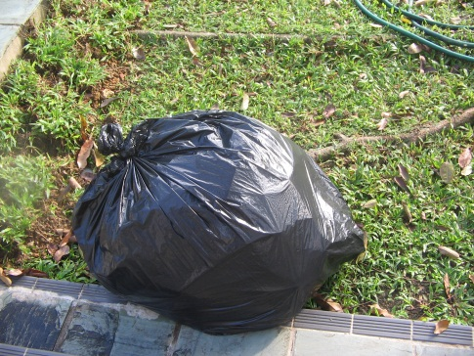
Why withered leaves?
Abundance
Daily disposal of leaves as waste
Presence of cellulose
Notes:
minimal fossil fuels required -- for e.g, no energy needed for ion exchange
alternatives that require electricity cause carbon emission
Methods that require activated carbon causes carbon emission.
cost - resources can be chanelled to developing
rainwater composing of poisonous heavy metal ions such as lead (II) and cadmium will poison plants, that take in carbon dioxide during photosynthesis. thus, the amount of greenhouse gases in the atmosphere will increase.
minimal fossil fuels required -- for e.g, no energy needed for ion exchange
alternatives that require electricity cause carbon emission
Methods that require activated carbon causes carbon emission.
cost - resources can be chanelled to developing
rainwater composing of poisonous heavy metal ions such as lead (II) and cadmium will poison plants, that take in carbon dioxide during photosynthesis. thus, the amount of greenhouse gases in the atmosphere will increase.

Slide 6
Objectives
Investigate whether withered leaves from Khaya Trees are able to adsorb metal ions.
Investigate how chemical modification affects the leaves’ ability to adsorb metal ions
Determine the optimum combination of conditions(e.g. pH) which can maximise the adsorption ability of the withered leaf species

Slide 7
Hypotheses
Withered leaves are able to adsorb heavy metal ions due to their chemical composition
Chemical modification improves the ability of leaves in adsorbing metal ions

Slide 8
Variables
Independent variables
Chemical modification
Metal ion
pH
Dependant variables
Amount of metal ions adsorbed
Controlled variables
Mass of leaves used
Stirring Time
Stirring rate
Temperature
Volume of metal ion solution
Initial concentration of metal ion

Slide 9
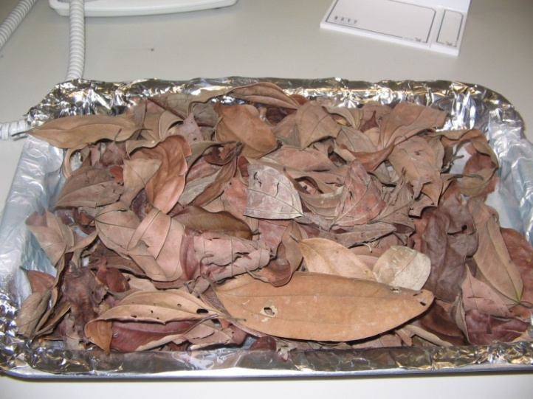
Materials Used
Leaves from:
Khaya Trees
0.4 mol/dm³ NaOH, 0.4 mol/dm³ HCl, Isopropanol
Potassium dichromate(VI)
Lead(II) Nitrate
Cadmium Nitrate

Slide 10
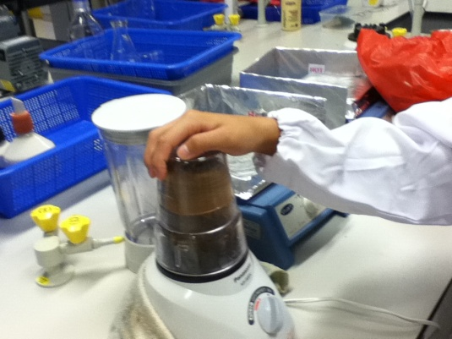
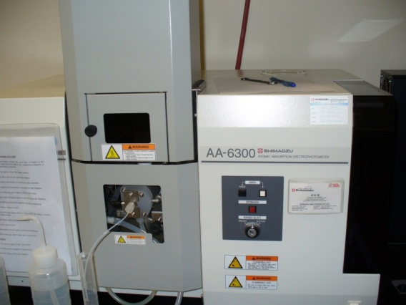
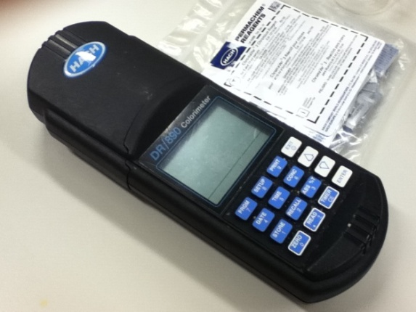
Apparatus & Equipment
Blender
Oven
Magnetic stirrer
Hot plate
Beakers
Filter funnel and filter paper
Colorimeter [analysis of Cr(VI)]
AA spectrometer (analysis of Pb²⁺ and Cd²⁺)

Slide 11
Preparation
Leaves were soaked in de-ionised water for 1 hour.
Leaves were dried in the oven at 70ºC for 1 day.
Leaves were ground into fine pieces.

Slide 12
Chemical Modification
Soaked 30g of leaves into 400ml of 0.4 mol/dm³ NaOH or 0.4 mol/dm³ HCl or isopropanol.
Washed the leaves until the washings are neutral.
Dried in oven at 70ºC for 1 day.

Slide 13
Adsorption
1g of leaves were weighed into a beaker.
50 ml of 50 ppm metal ion solution was added.
Mixture was stirred for 90 minutes.
Mixture was filtered.
Filtrate was collected and analysed for concentration of metal ion remaining.

Slide 14
pH studies
Metal ion solution was altered to
desired pH level (pH 2 - pH6) using NaOH or HNO₃

Slide 15
Results
Most effective
Acid treated leaves are most effective in removing Chromium(VI)

Slide 16
Results
Most effective
All the four types of leaves are effective in removing lead(II) ions with the percentage of Lead removed being at least 90% .
Again HCl treated leaves is the most effective in adsorbing lead(II) ions.

Slide 17
Results
Most effective
NaOH treated leaves is the most effective at removing Cadmium (more than 90%).

Slide 18
Results
Most effective
Acid treated leaves has the most potential as it can remove at least 65% of all the three metal ions.

Slide 19
Results
Most effective
The adsorption of all types of leaves is more effective at pH 4 and pH 6
NaOH treated leaves shows effective adsorption at all pH

Slide 20
Results
Most effective
The adsorption of all types of leaves is most effective at pH 2
The adsorption of all types of leaves is the least effective at pH 4.76
HCl treated leaves shows effective adsorption at all pH

Slide 21
Results
Most effective
The adsorption of all types of leaves is more effective at pH 4 and pH 6
The adsorption of all types of leaves is the least effective at pH 2
NaOH treated leaves shows most effective adsorption at all pH

Slide 22
Discussion
Hydroxyl groups of cellulose present in the cell walls of withered leaves bind to metal ions via co-ordinate bonds.

Slide 23
Discussion
How does chemical modification affect adsorption
Acid
Removes excess cations such as Ca²⁺ and Na⁺ which might interfere with binding.
Enhances adsorption of all three ions at pH 4
Alkali
Removes dissoluble components such as hemi-cellulose and pigments, exposing more binding sites
Enhances adsorption of cadmium

Slide 24
Limitations
Chemical treatment breaks down a large amount of leaves.
Large amount of leaves are required for modification.

Slide 25
Conclusion
Withered leaves can adsorb a significant amount of Cr (VI), Pb²⁺ and Cd²⁺ ions.
Acid treated leaves is the most effective at adsorbing Cr (VI) and Pb²⁺ ions at their original pH.
NaOH treated leaves is the most effective in adsorbing Cd²⁺ ions at its original pH.
Adsorption of Pb²⁺ and Cd²⁺ is most effective at their original pH and pH 6.
Adsorption of Cr (VI) ions is most effective at pH 2.

Slide 26
Optimum Combination
Chromium (VI)
Hydrochloric acid-treated leaves at pH 6 are most effective in removing Chromium (VI) metal ions.

Slide 27
Optimum Combination
Cadmium
Hydrochloric acid-treated leaves at pH 6 are most effective in removing Cadmium metal ions.

Slide 28
Optimum Combination
Lead (II)
Hydrochloric acid-treated leaves at original pH 4.12 are most effective in removing Lead (II) metal ions.

Slide 29
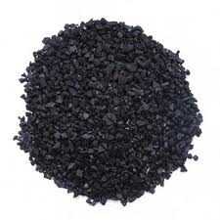
Enviromental Friendly Alternative
Other methods (e.g. reverse osmosis) lead to higher carbon emission: Ion exchange requires energy; Activated carbon production releases CO₂
Lower cost: resources can be channelled into developing other technology
Activated carbon

Slide 30
Further Studies
Investigation of the absorption ability of other common heavy metal ions such as manganese (II) and copper (II) ions by Khaya leaves.
Kinetic studies can also be carried out.
Variables such as the initial concentration of heavy metal ion solution and contact time between the leaves and the ions can be altered.
Create a prototype such using Khaya Leaves to remove metal ions more efficiently

Slide 31
Bibliography
Universtity, of Waikato. (n.d.). Plant structure & function. Retrieved from http://sci.waikato.ac.nz/farm/images/cellulose%20structure%20RF.jpg
Yoshita A. et al.(2009). Sorption of lead from aqueous solutions by spent tea leaf. African Journal of Biotechnology, 8(10), 2212-2217.
Zuorro, A, & Lavecchia, R. (2010). Adsorption of Pb(II) on spent leaves of green and black tea. American Journal of Applied Sciences, 7(10), 153-159.
Bhattacharya, J, & Mishra, S. (2006). Potential of leaf litter for phenol adsorption ⎯a kinetic study. Indian Journal of Chemical Technology, 13, 298-301.
Mane, P.C. et al. (2010). Chromium adsorption onto activated carbon derived from tendu (diospyros melanoxylon) leaf refuse: influence of metal/carbon ratio, time and ph. Applied Science Research, 1(3), 212-221.
Kandah, M.I. (2010). Adsorption of cadmium onto activated and non-activated date pits. World Academy of Science, Engineering and Technology,
Pielichowska, M, & Wierzbicka, M. (2004). Uptake and localization of cadmium by biscutella laevigata, a cadmium hyperaccumulator. ACTA BIOLOGICA CRACOVIENSIA Series Botanica, 46, 57-63.
Dash, S.N., & Murthy, R.C.V. (2010). Preparation of carbonaceous heavy metal adsorbent from shorea robusta leaf litter using phosphoric acid impregnation . International Journal of Environmental Sciences, 1(3), 296-313.
Gupta, S, & Babu, B V. Adsorption of chromium (VI) by a low-cost adsorbent prepared from tamarind seeds.

Slide 32
Thank You!

