Slide 1

For long time travel:
A walking crisper
Tianjin Nankai High School
Yang Yujing, Yi Jiangyue, Zhao Yufei, Ma Yiting

Slide 2
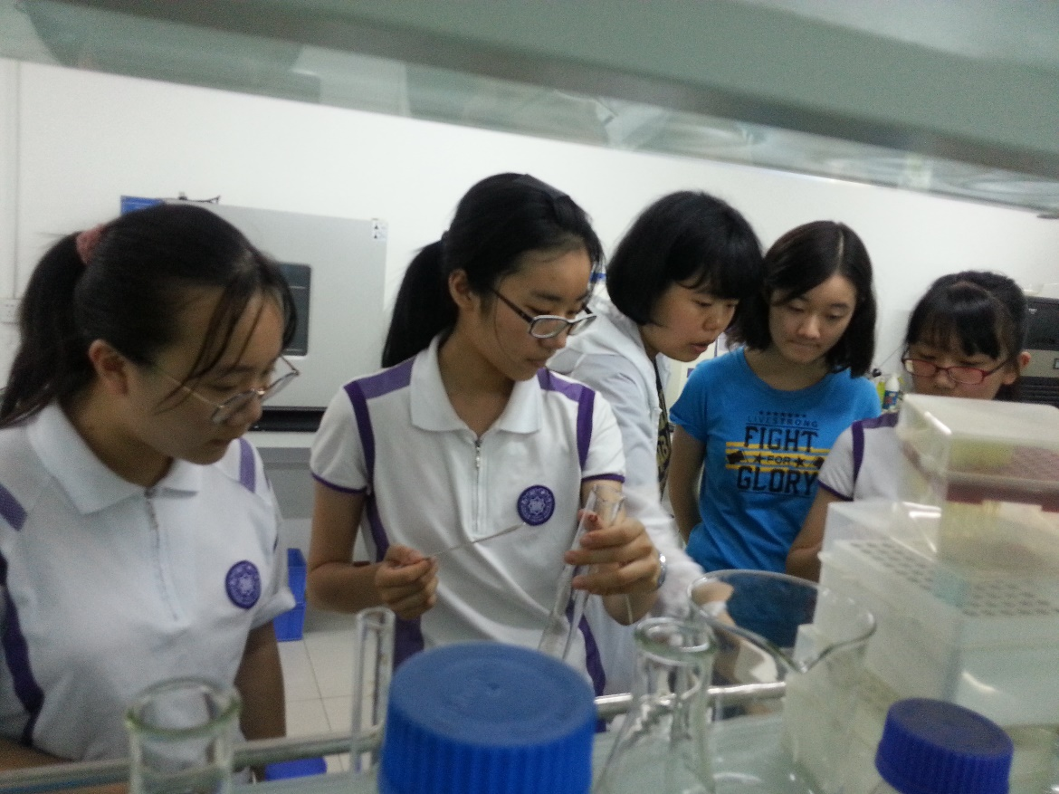
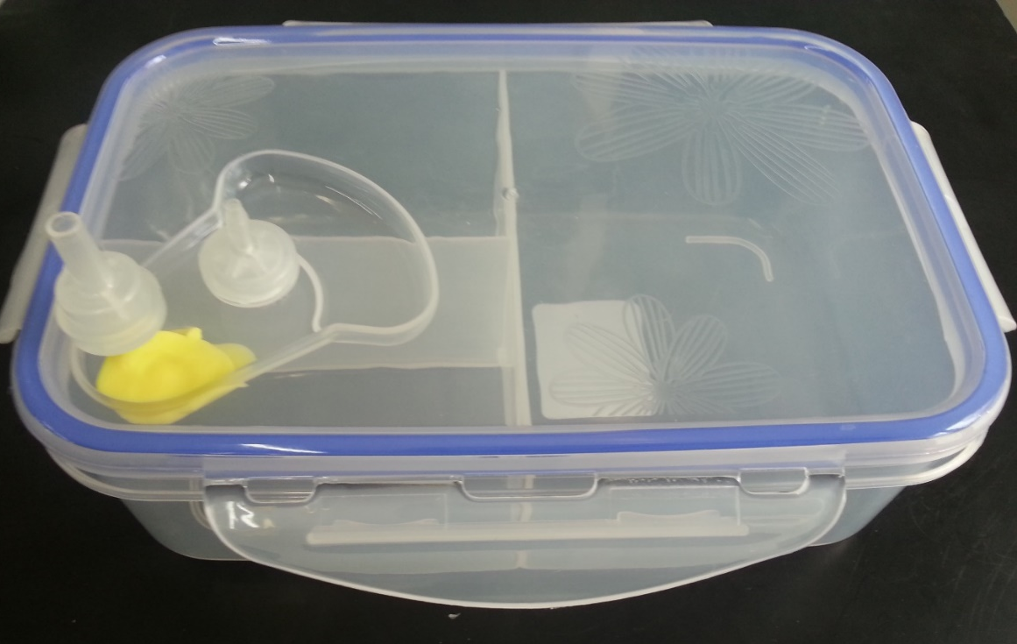
Inspirations
▷Travelers’ preference
▷Functions of lunch box
and check valve
▷Easily home-made

Slide 3
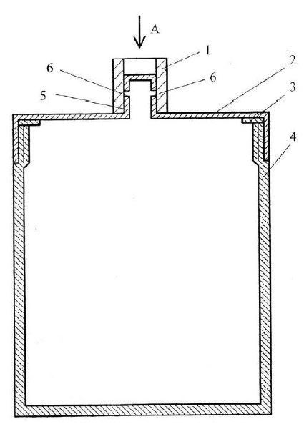
II. Assembly Drawing
1 Seal Pipe
2 Lid
3 Seal Ring
4 Jar Body
5 Cylinder
6 Air Hole

Slide 4
III. Experiment
Experimental apparatus:
Lunch boxes, check valves, a piece of plasticine, glues, electronic balances, spoons, filter paper, beakers, glass rods, asbestos net, an electric furnace, culture mediums, an autoclave, induction cooker, and a pot.
Experimental material:
Beef extract, peptone, powder agar, sodium chloride, and water.

Slide 5
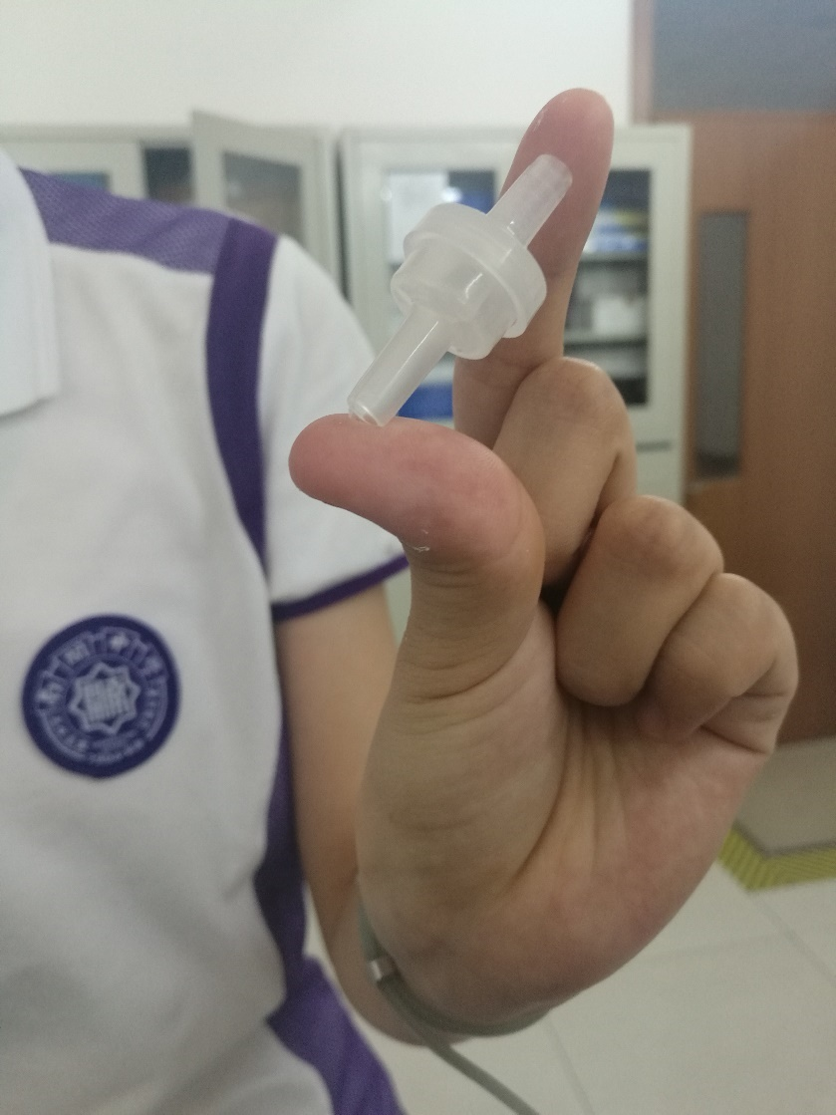
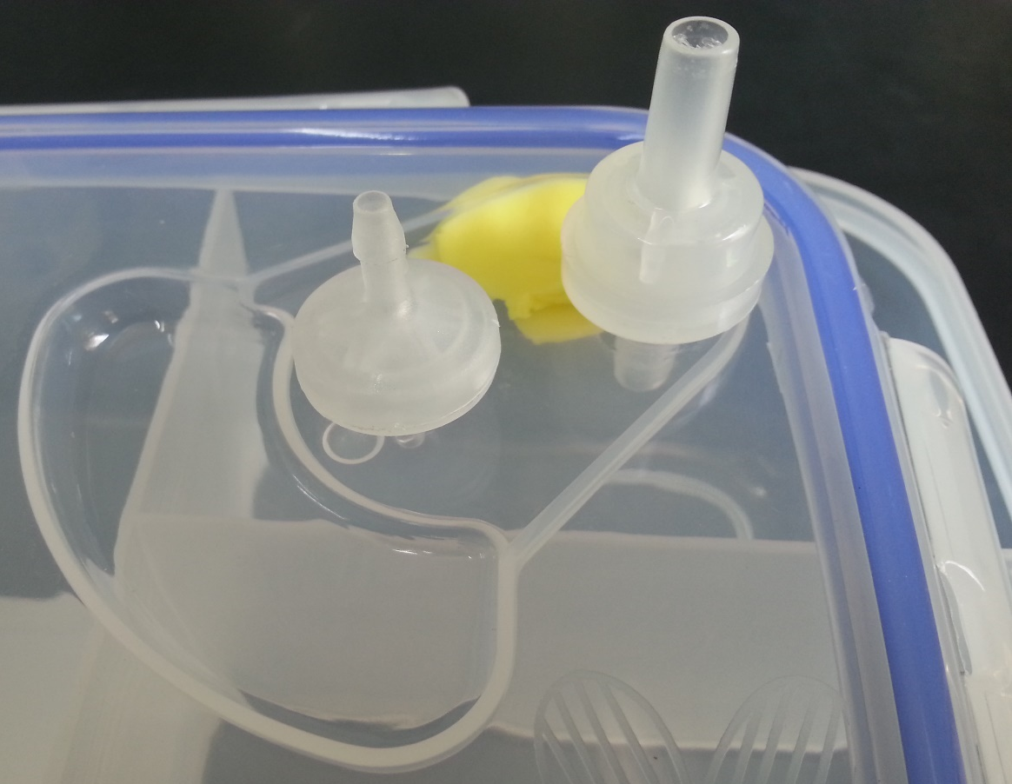
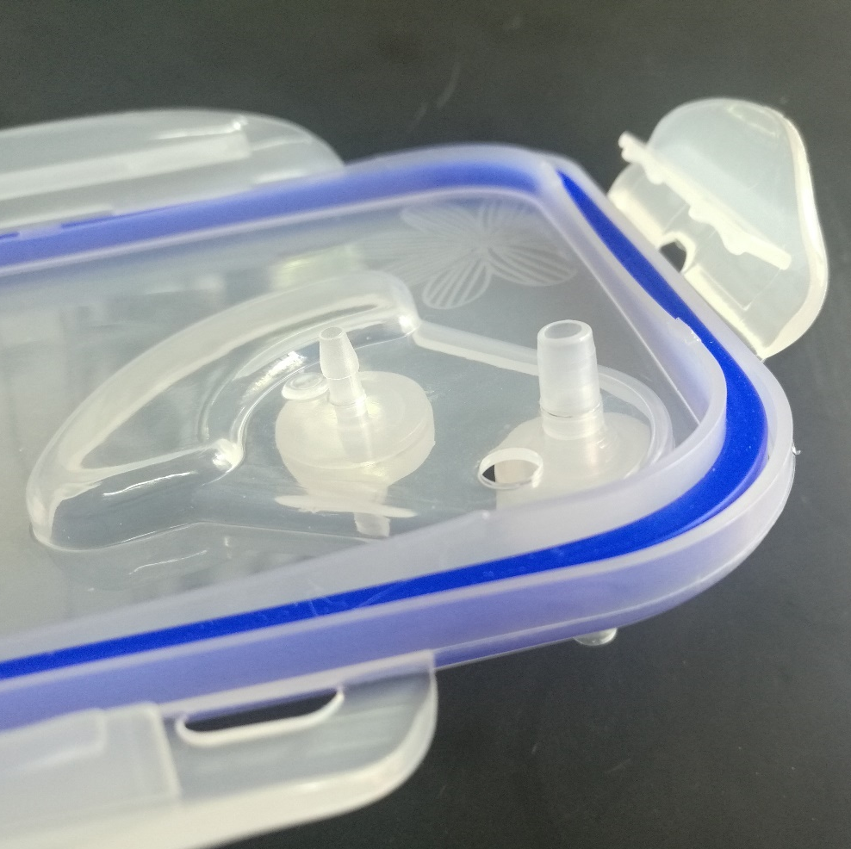
Step 1: Make our own lunch box

Slide 6
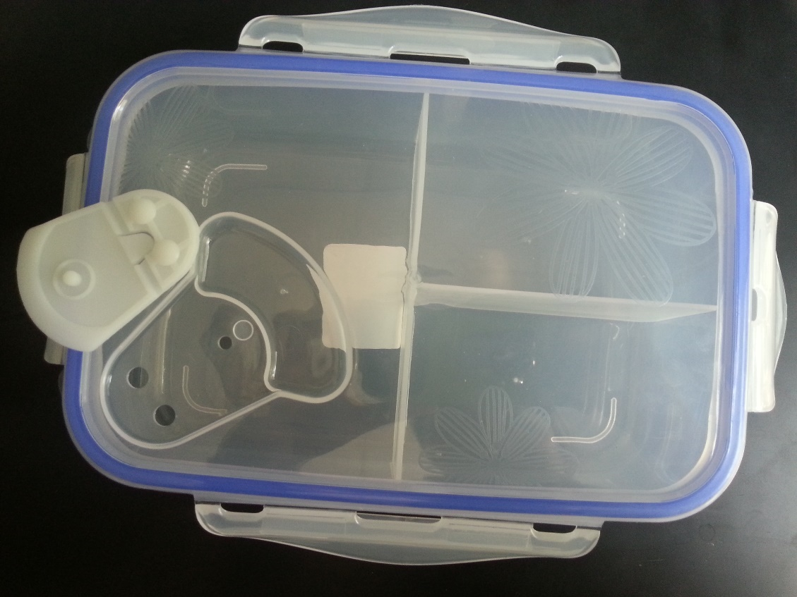
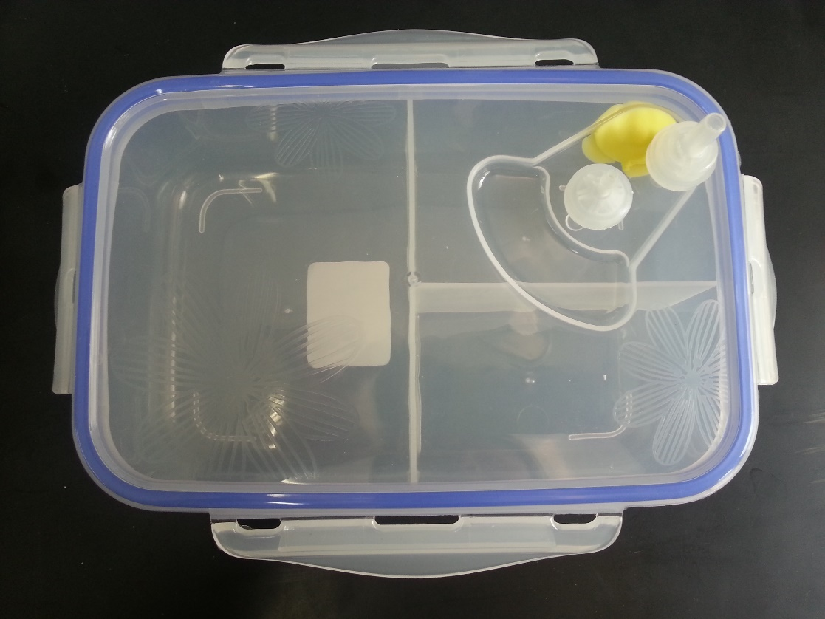
☟Experimental Group
☝Control Group

Slide 7
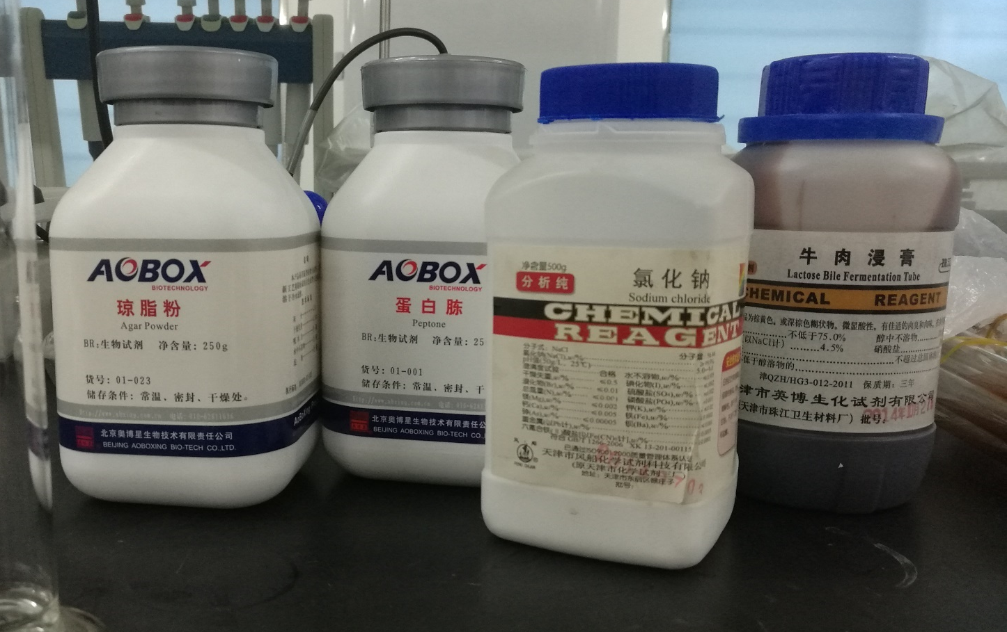
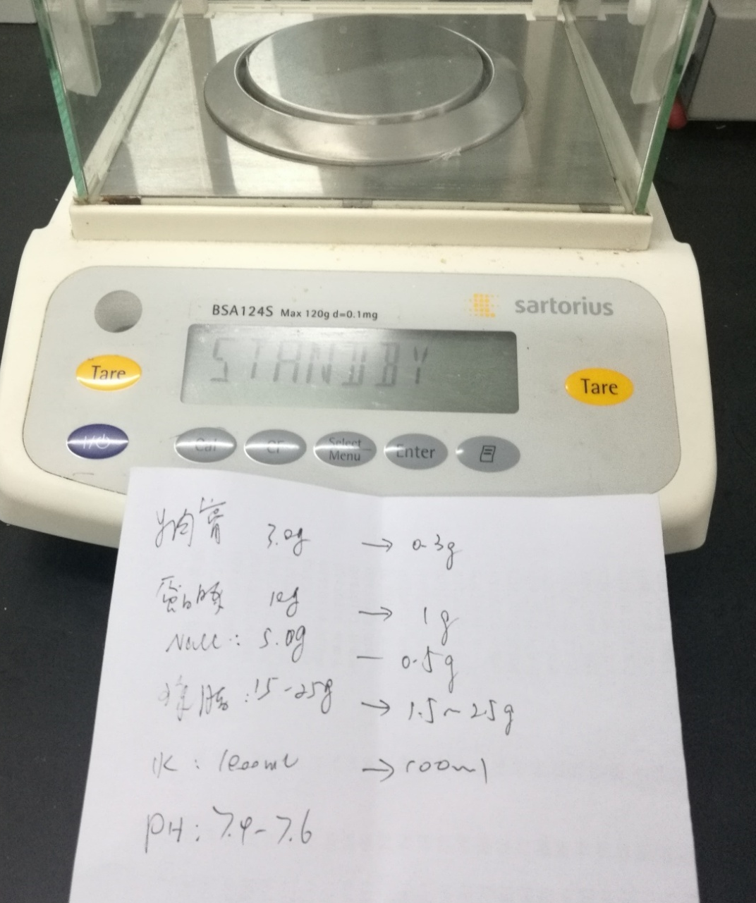
Step 2: Weighing
Beef extract: 0.3g
Peptone: 1g
NaCl: 0.5g
Powdered Agar: 1g
Water: 100mL

Slide 8
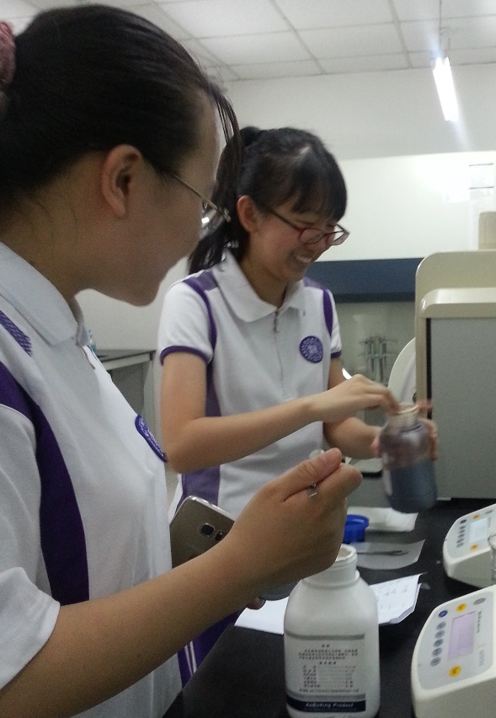
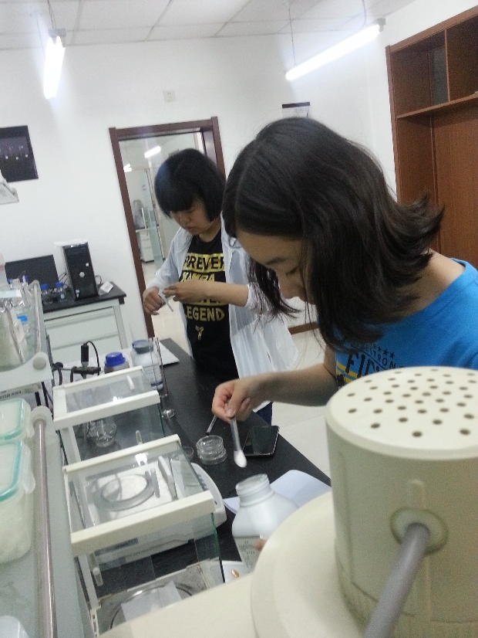
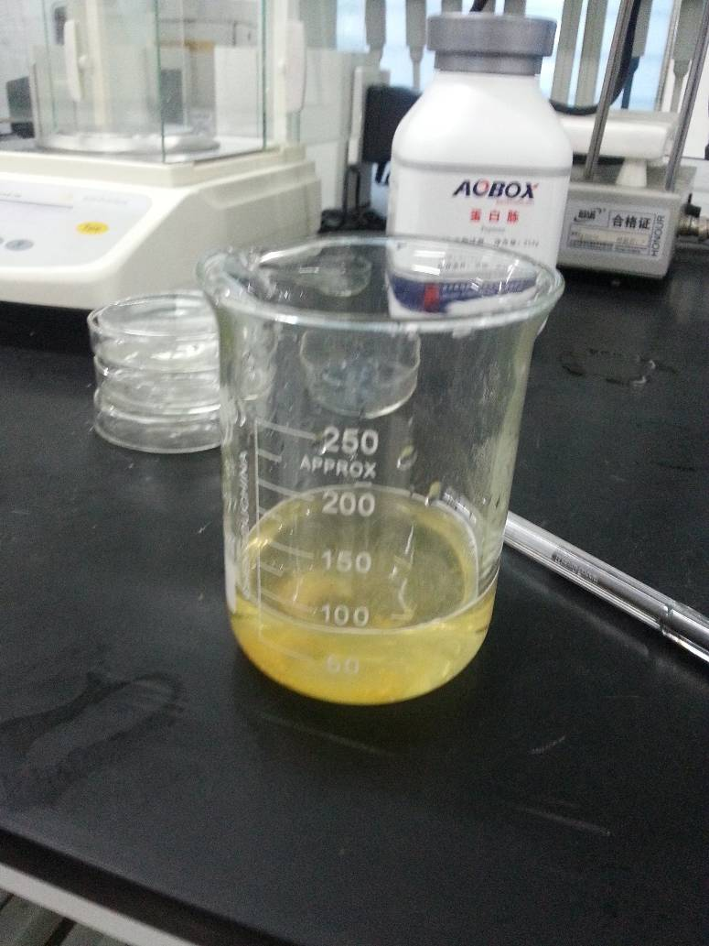
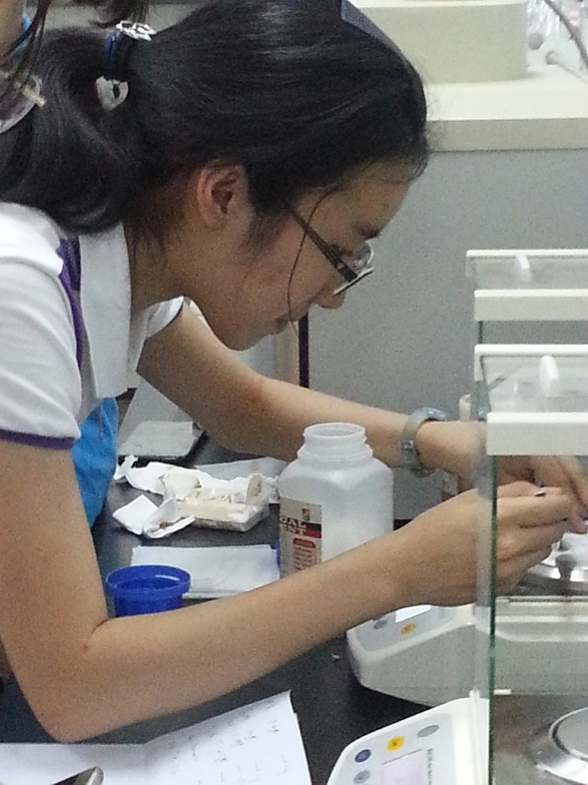
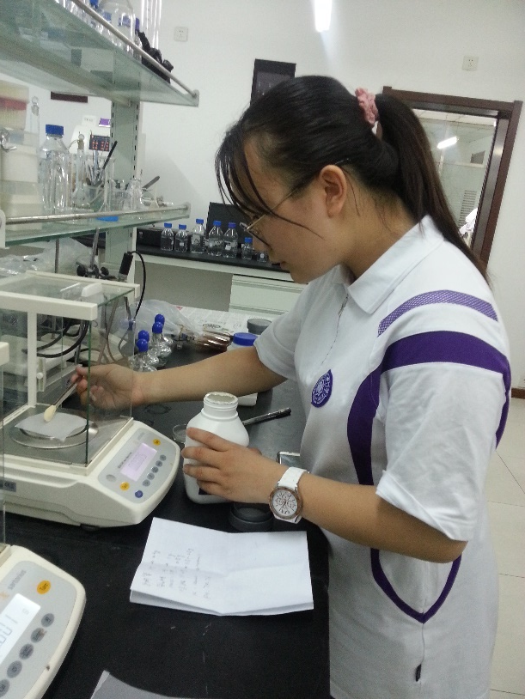

Slide 9
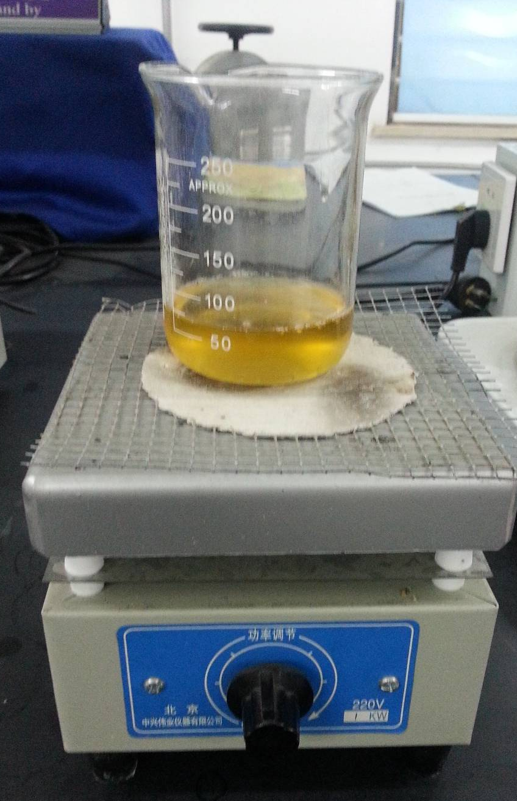
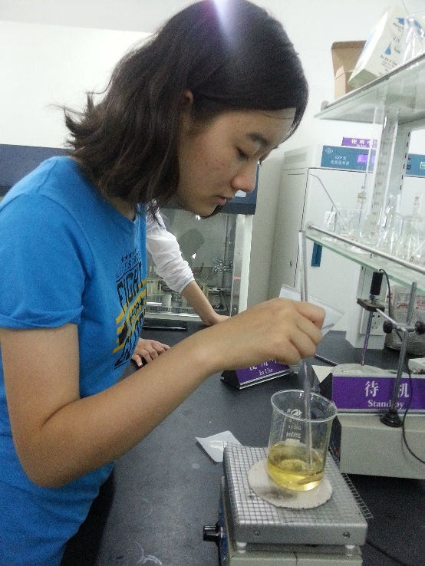
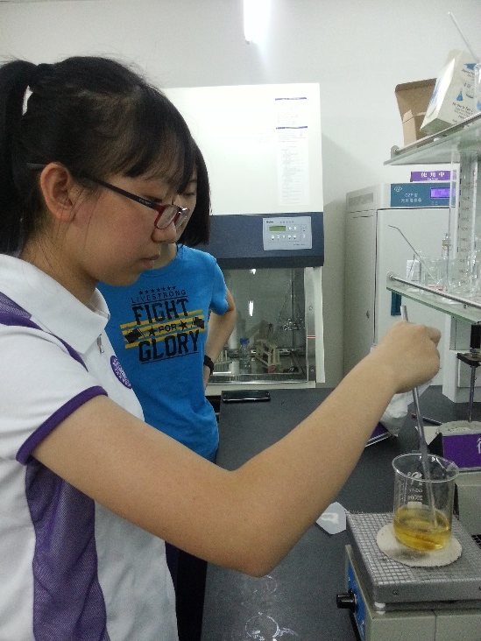
Step 3: Solute and Divide
1）Put beef extract and water (less than 100mL) into a beaker and keep heating.
2）Add peptone and NaCl.
3）Add powdered agar and keep stirring until it solutes.
4）Stop heating and add water until the solution reaches the amount of 100mL.

Slide 10
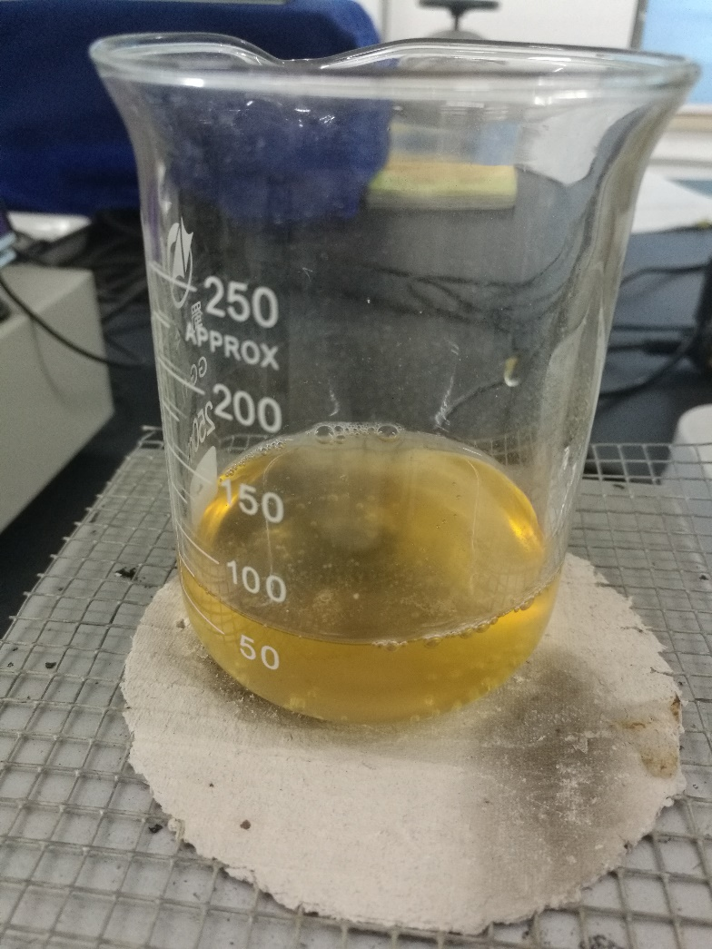
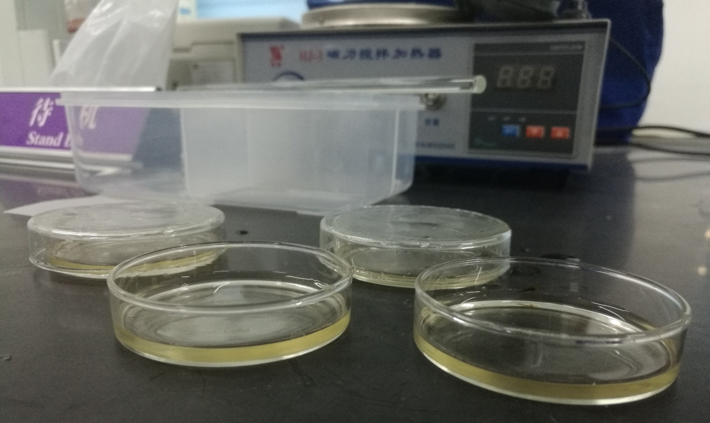
5）Divide the solution into several culture mediums.

Slide 11
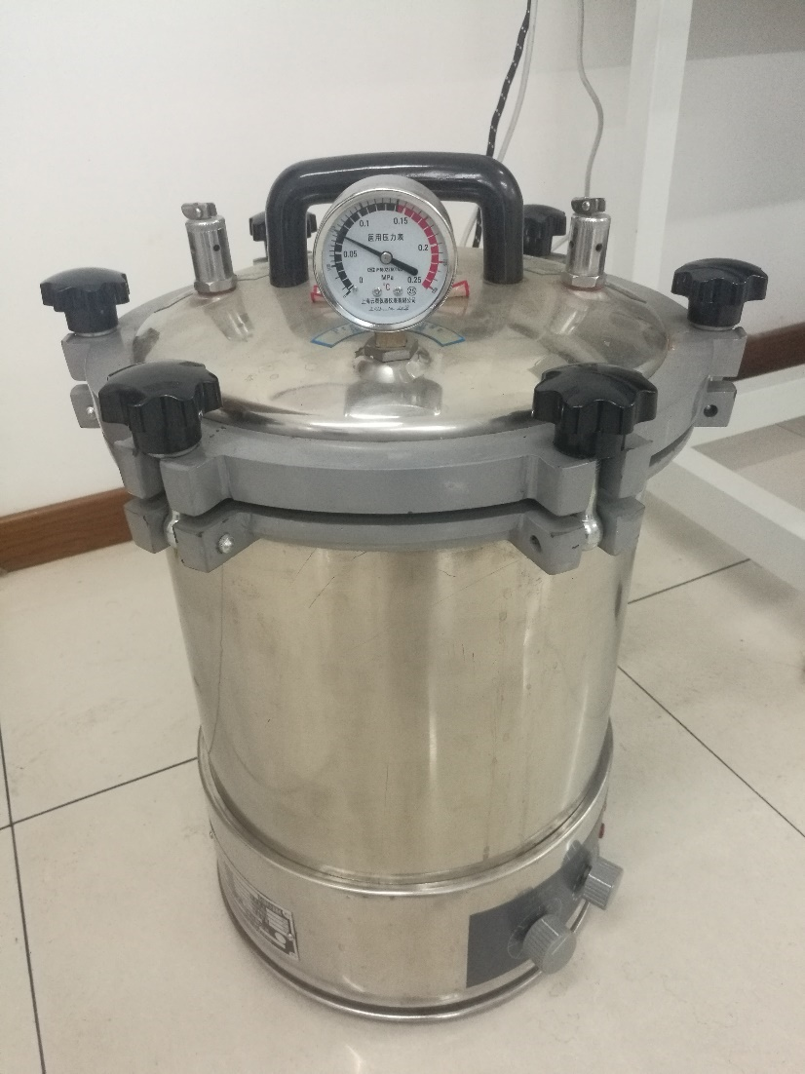
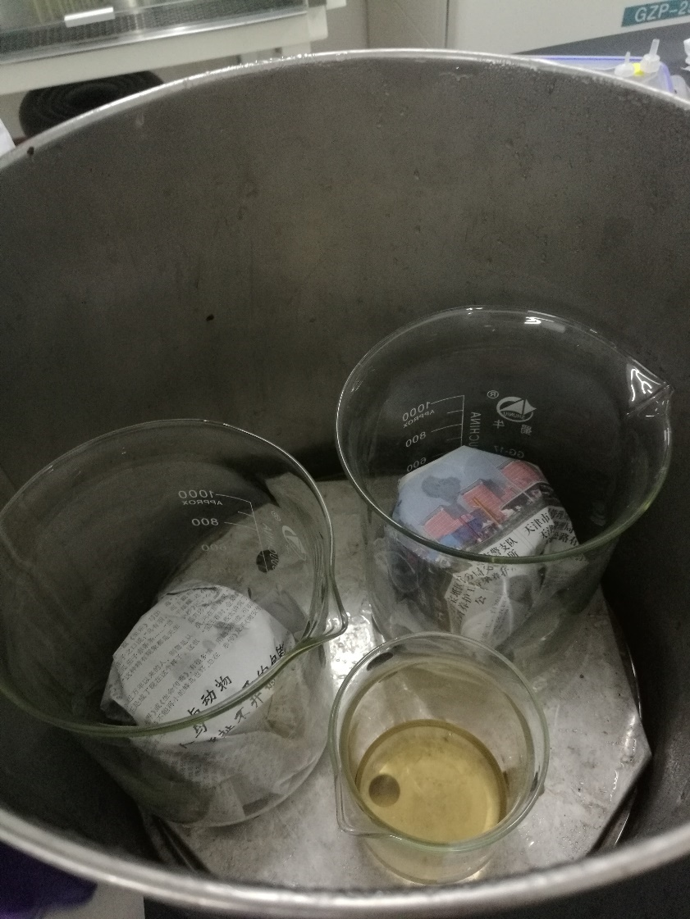
Step 4. Sterilize

Slide 12
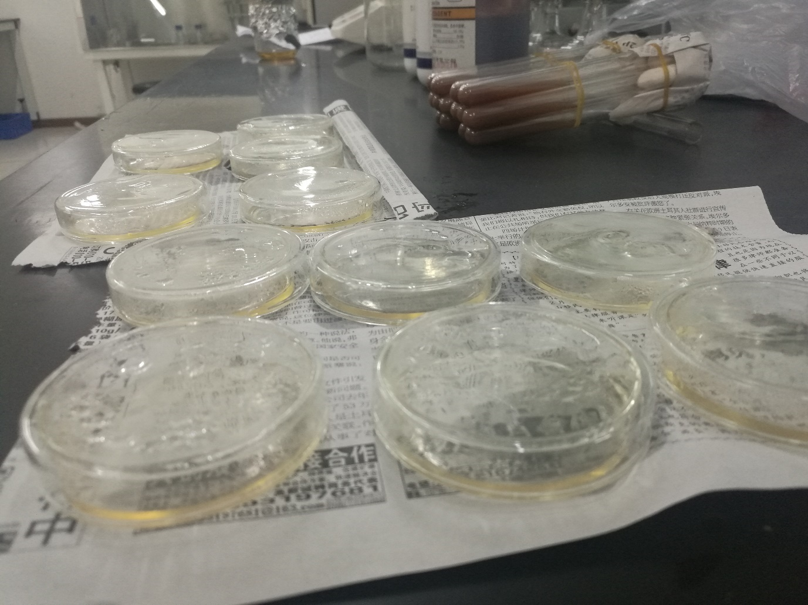
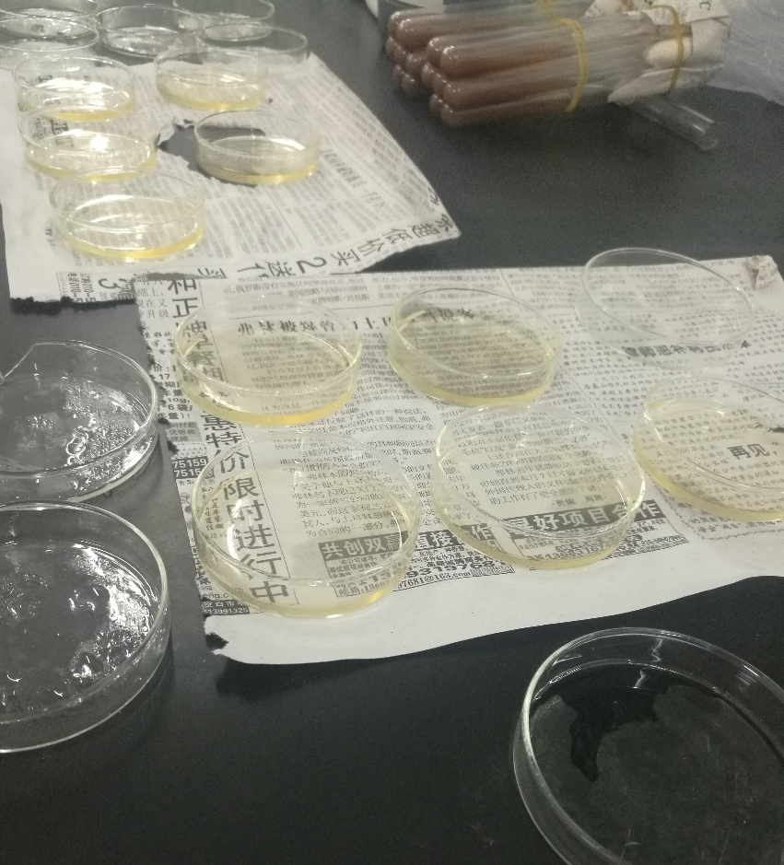
Step 5. cooling
& bacteria settling

Slide 13
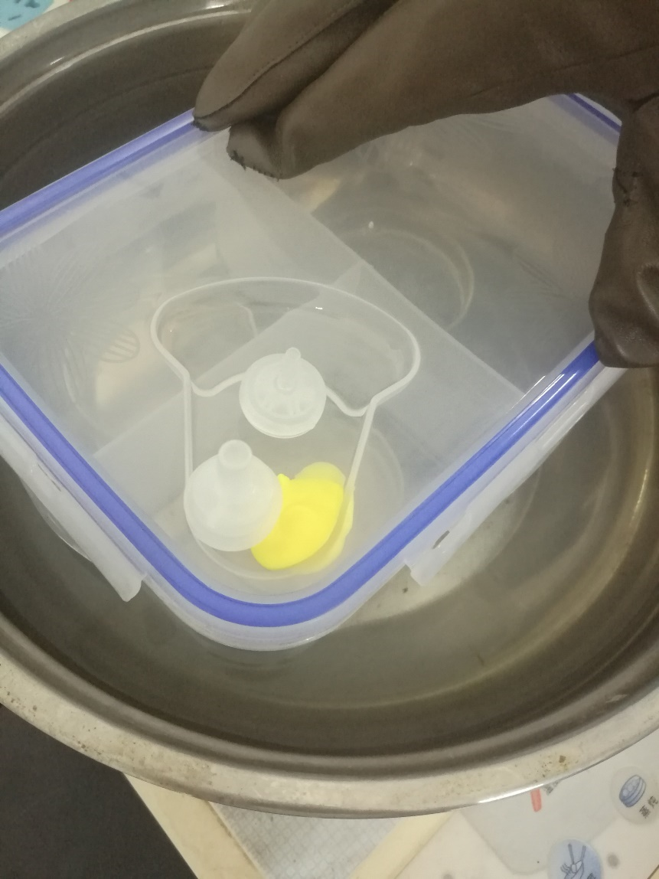
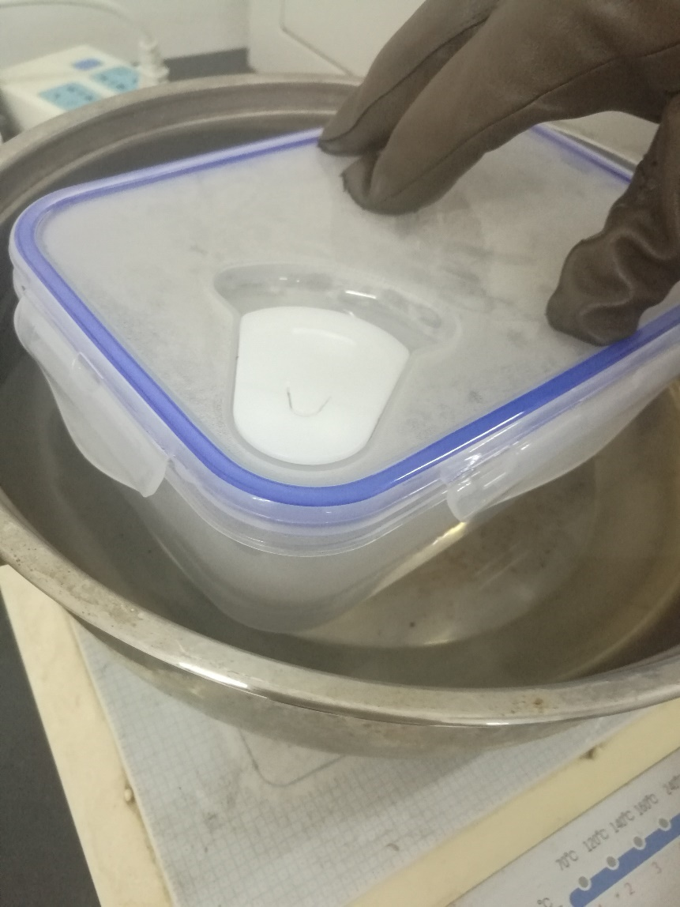
Step 6. PUT dishes into boxes step 7. heat UP

Slide 14
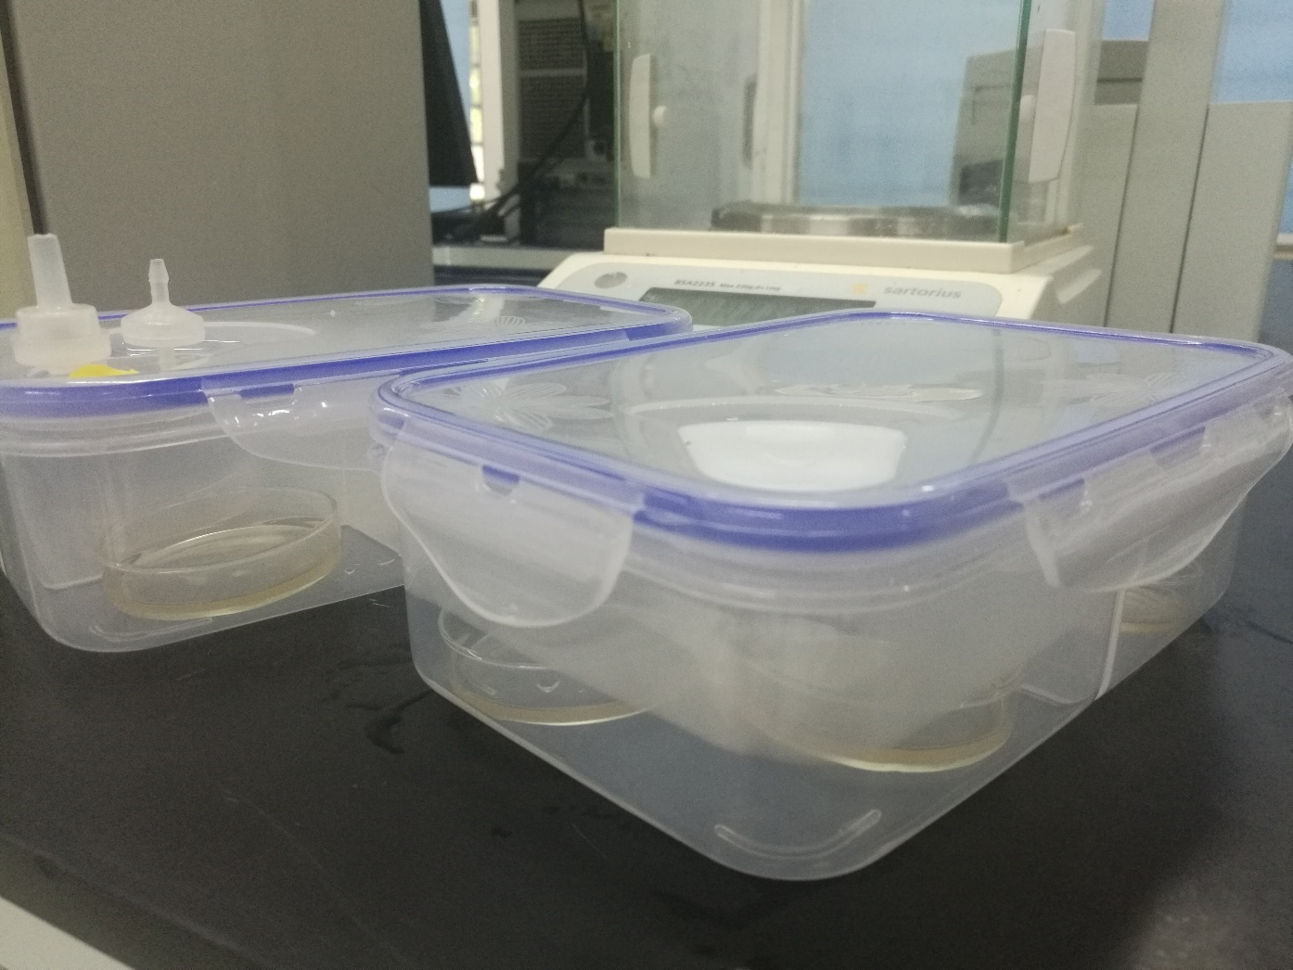
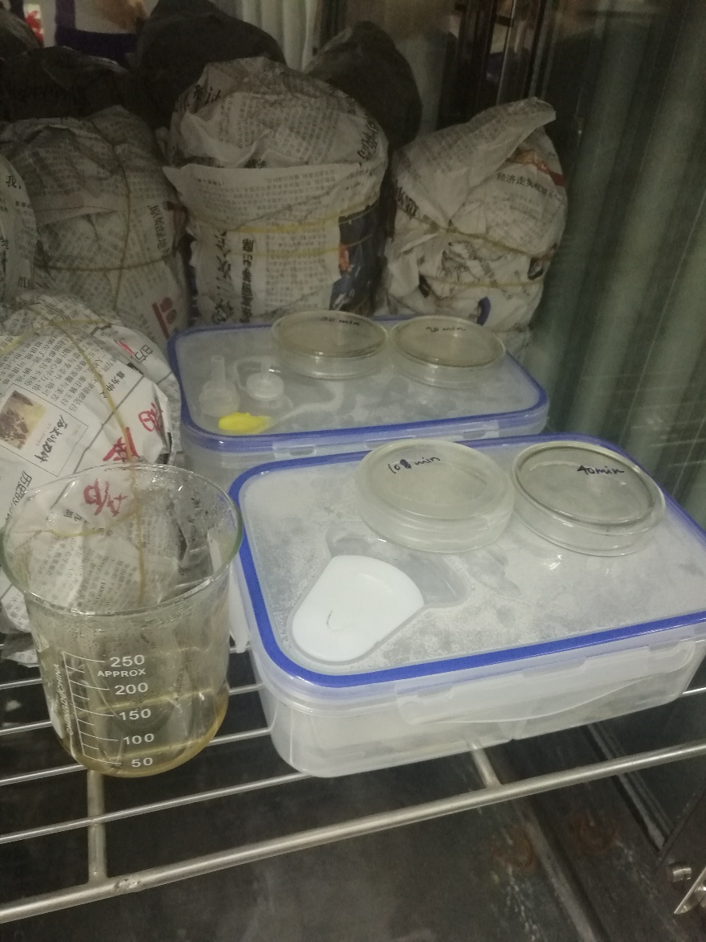
Step 8. incubation

Slide 15
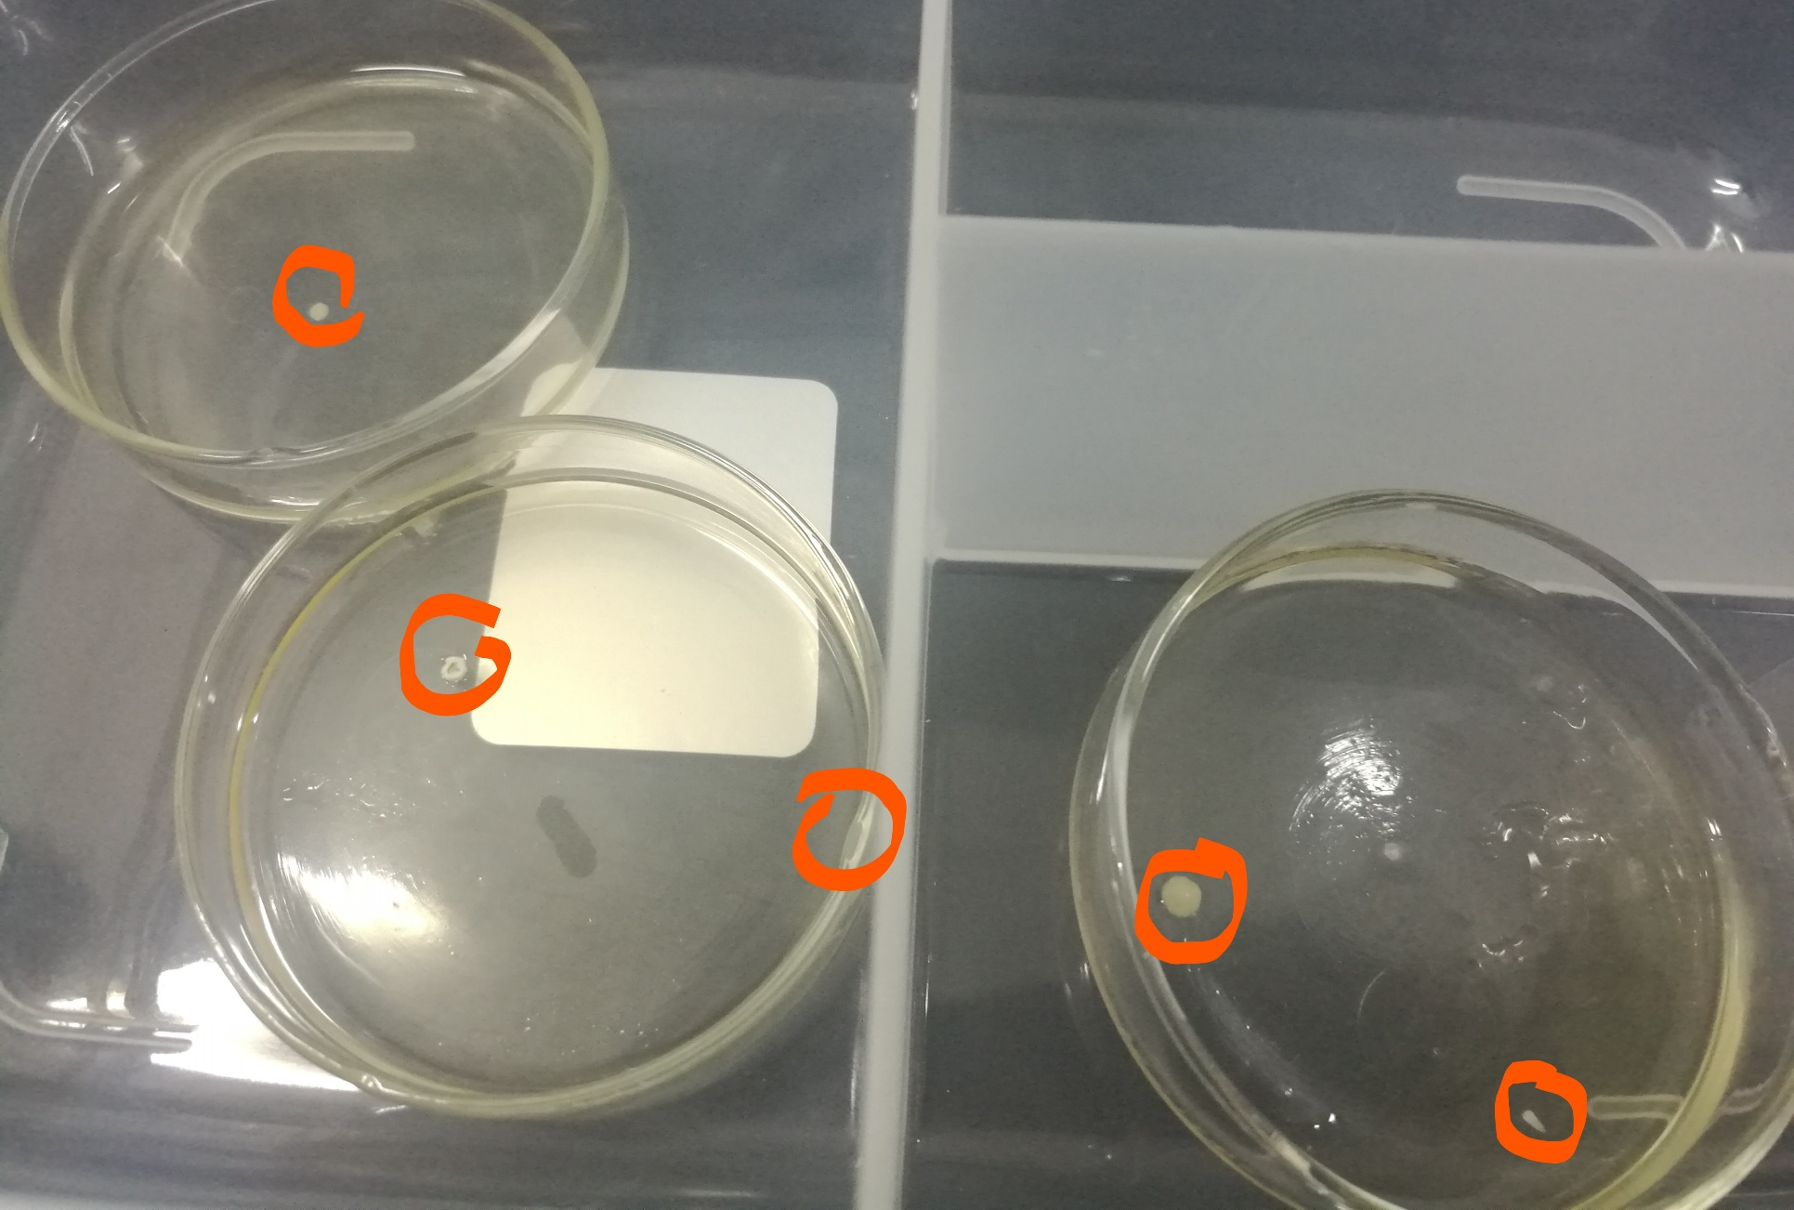
Step 9. observe: control group

Slide 16
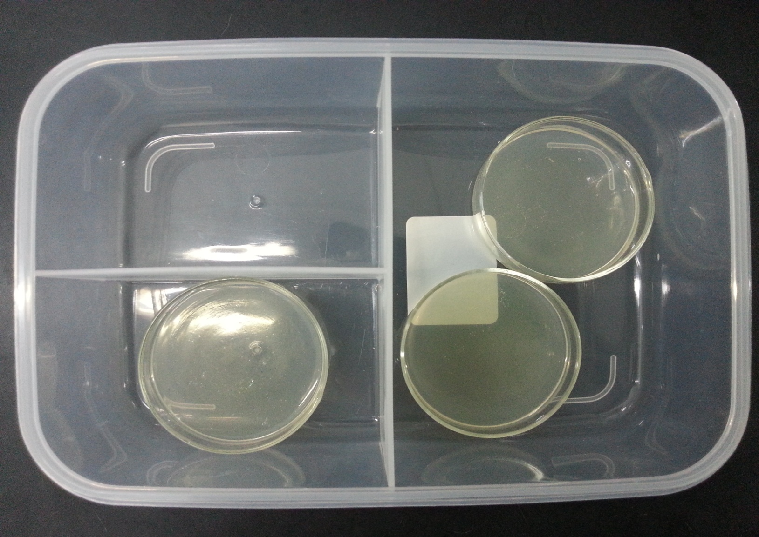
Step 9. observe: experimental group

Slide 17
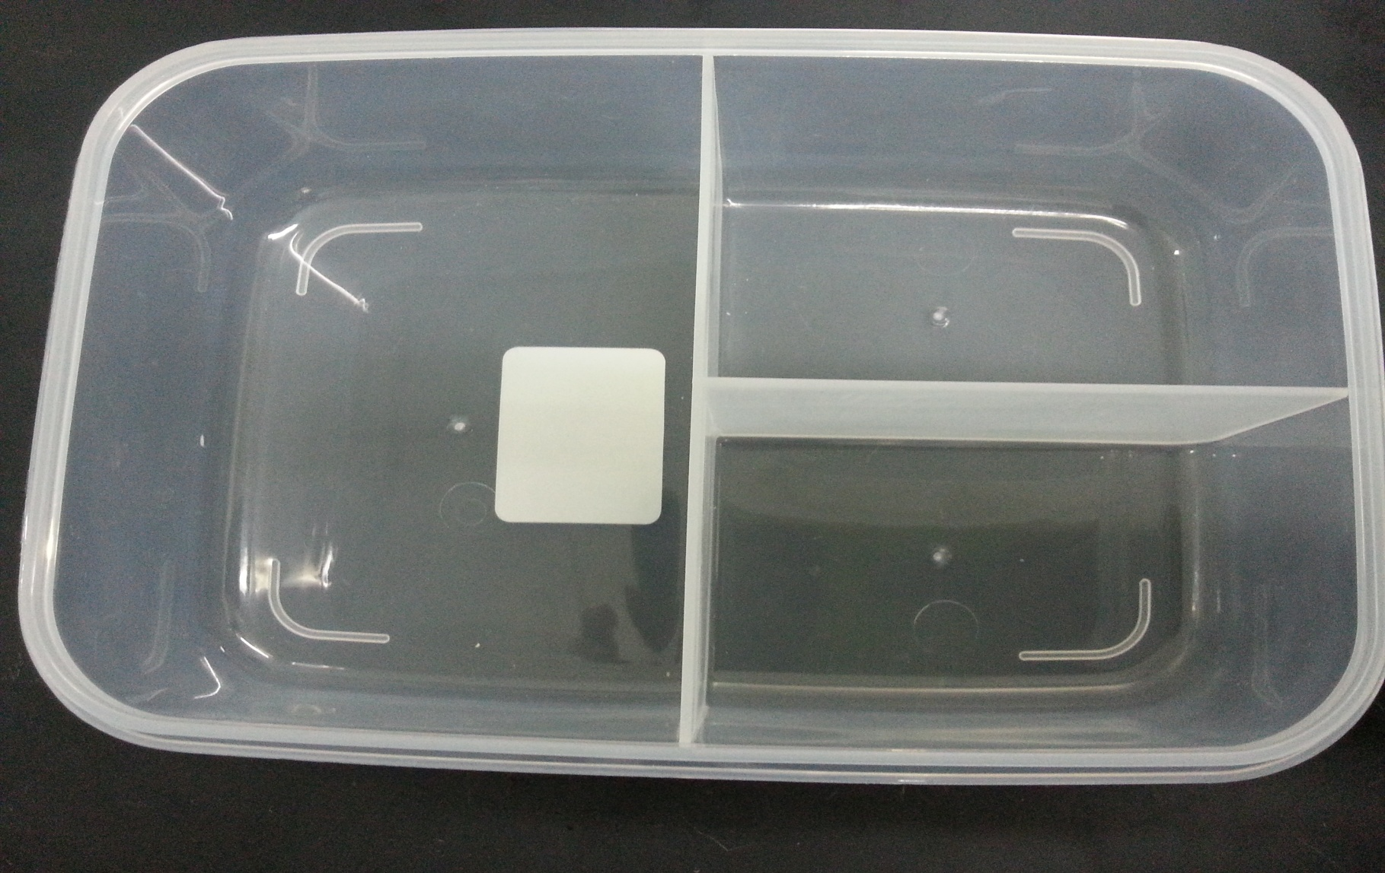

Slide 18
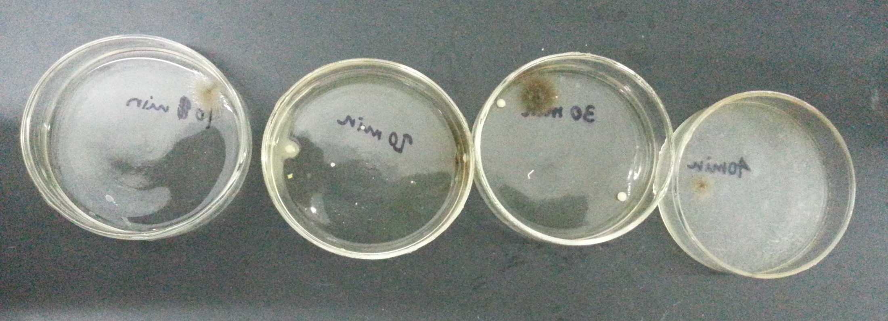
STEP 9. OBSERVE

Slide 19
IV. Summary
Experiment Conclusion
Check valve improves the preservation ability of lunch boxes.
Suggestion
It is better to preserve the food in lunch boxes instead of plates.
(page 18)
Error Analysis
Difference in the amount of culture solution in each dish;
Difference in the respective time of cooling;
Lack of experimental/control groups.
Improvement of Appearance

